Slide 1


ModelWriter Text & Model-Synchronized Document Engineering Platform
Project Leader: Ferhat Erata (ferhat@computer.org)
Project Email: project@modelwriter.eu

Slide 2
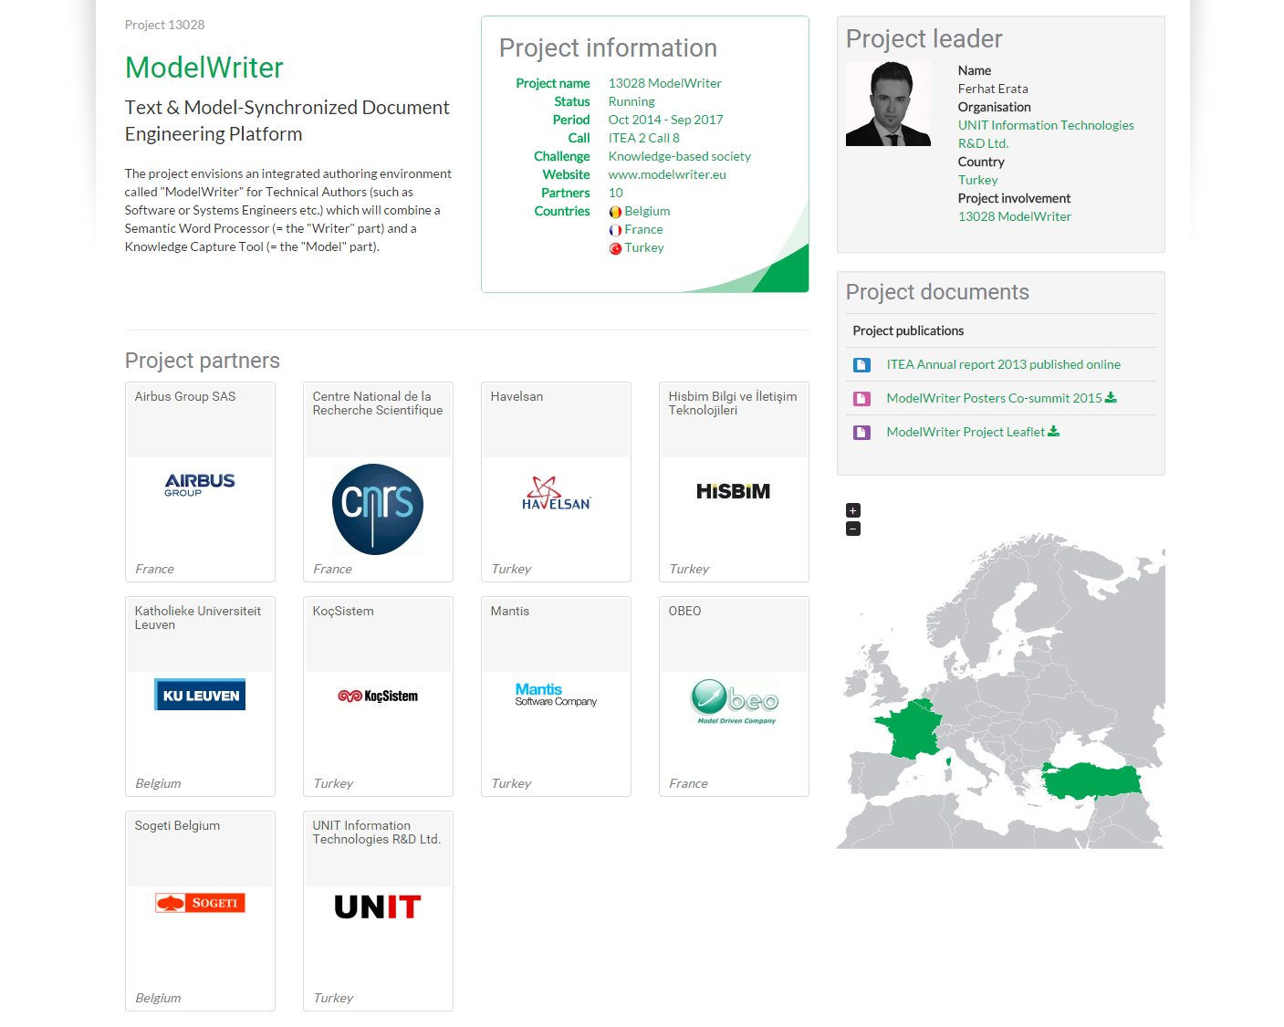
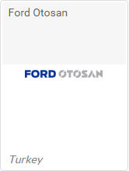
Industrial End User. Application Lifecycle Management (ALM)
Industrial End User.
Testing & Global Engineering Services
Industrial End User.
Product Lifecycle Management (PLM)

Slide 3
ModelWriter Project Overview
Resource Allocation: 68,71 person year
Project Duration: 36 months
Planned Budget: 5,543,000 Euro
Start and Finish Date: 01 Oct 2014 – 30 Sep 2017
Open-Source Software Platform to be submitted to Eclipse Foundation

Slide 4


Collaboration in ModelWriter Actions of UNIT
Modeling, Design & Simulation Lab.
Prof. Hans Vangheluwe
Prof. Geylani Kardaş
Dr. Eray Tüzün
Actions taken by UNIT
McGill University & University of Antwerp
Multi-Paradigm Modeling, Formalism Transformation,
Interaction in communication with European partners
Multi Agent Software Lab.
Ege University
Domain Specific Modeling Languages
Application Lifecycle Management Department
Application Lifecycle Management, Model Driven Engineering

Slide 5
What is the problem?

Slide 6
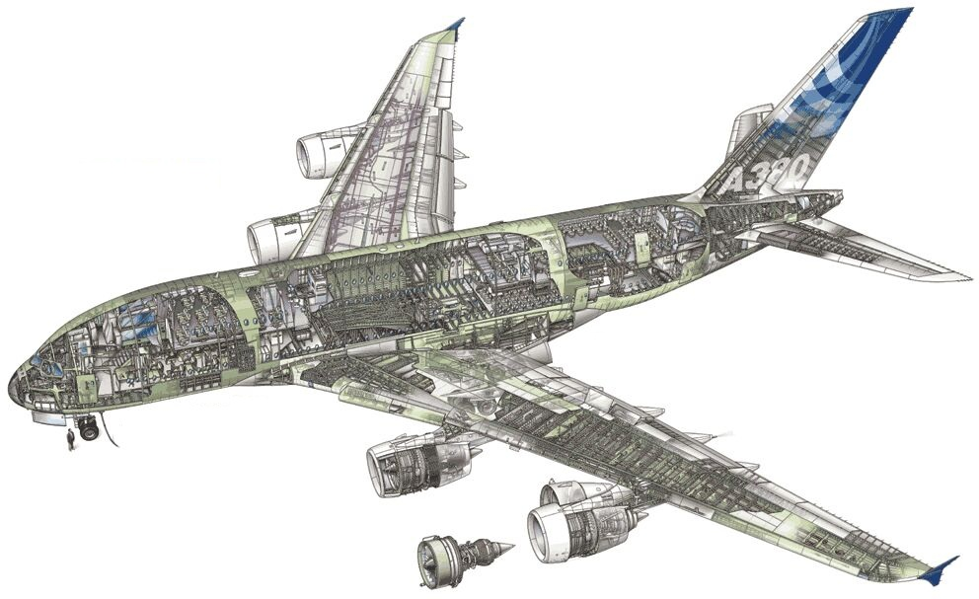
Airbus A380!
Imagine the documentation related to design principles.

Slide 7

Plants!
Imagine the documentation of a construction site.

Slide 8
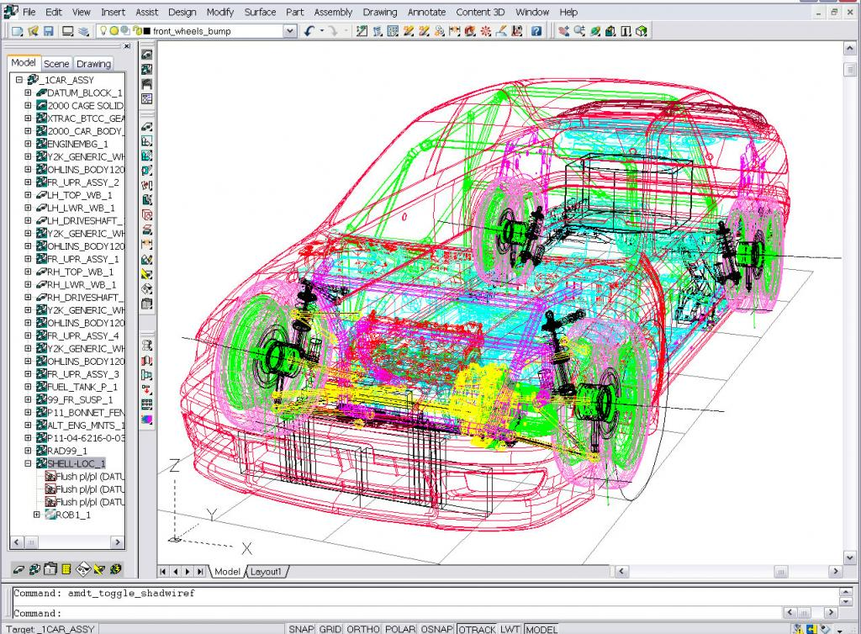
Automobiles!
Imagine the technical specifications

Slide 9
Documentation!
Write once … and never look at after

Slide 10
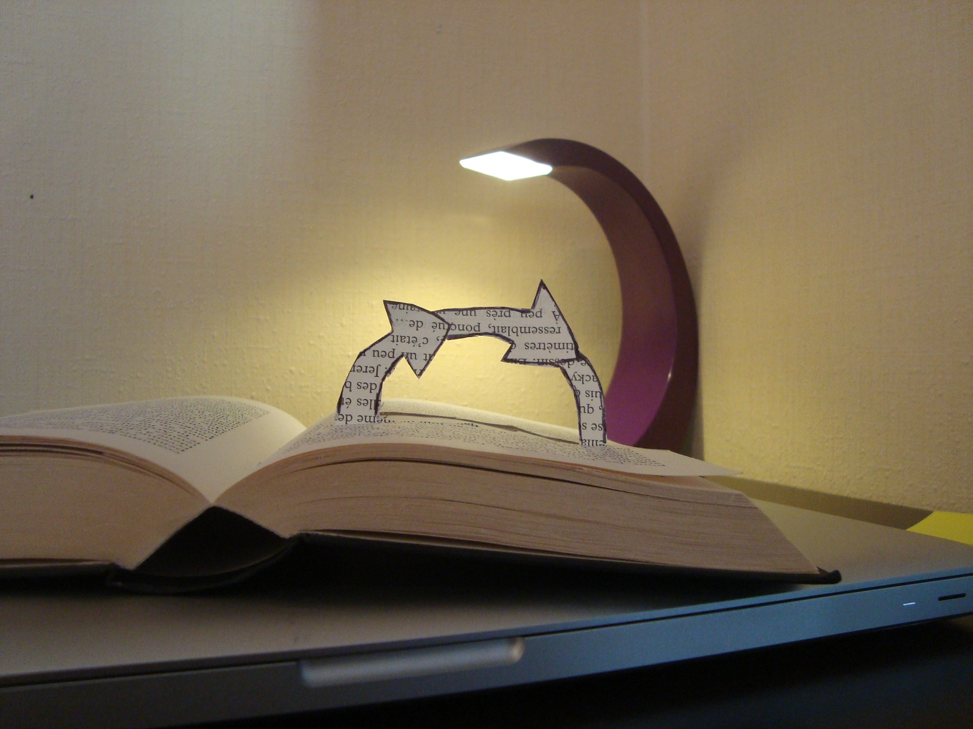
Documentation!
Hard to keep it up-to-date

Slide 11

Documentation!
Useful for users / Boring to write

Slide 12

Semantics!
No meaning of syntax (words, sentences …)

Slide 13
What is a text?

Slide 14
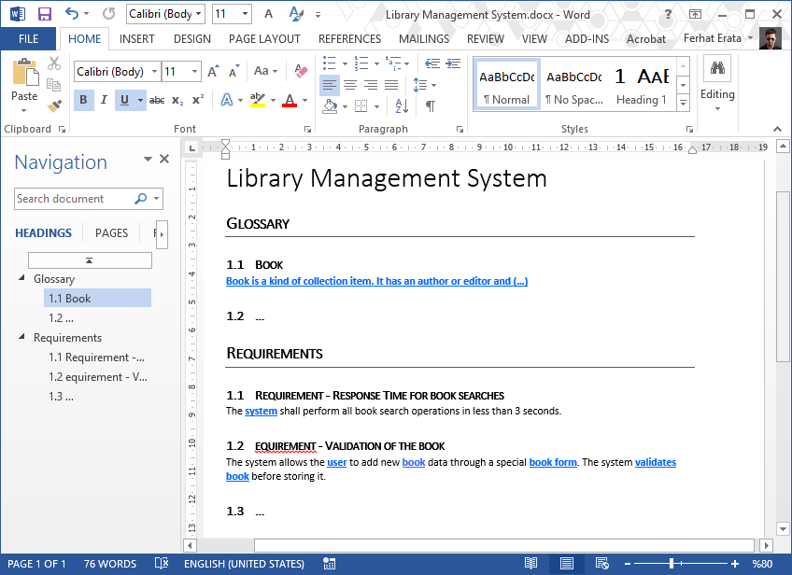
What is a text? (document file formats) Office Open XML (.docx) (ISO/IEC 29500)

Slide 15
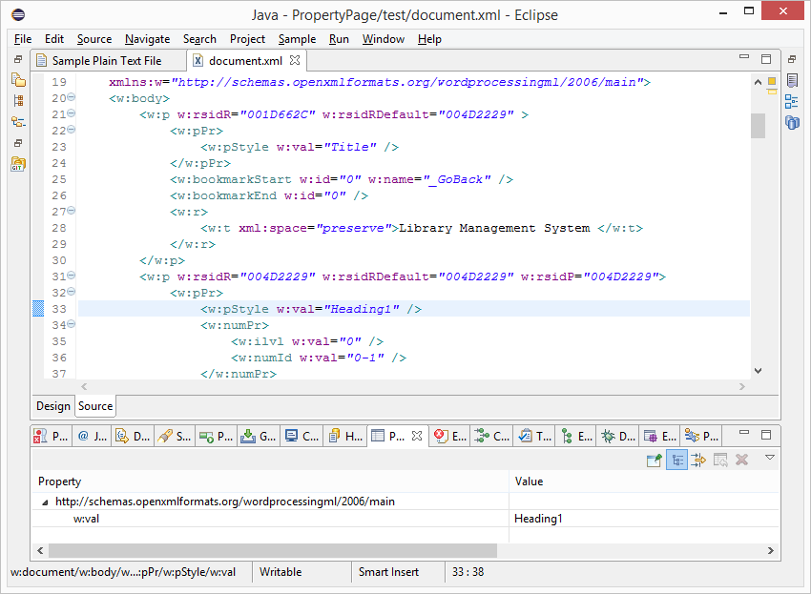
What is a text? (document file formats) Office Open XML (.docx) (ISO/IEC 29500)

Slide 16
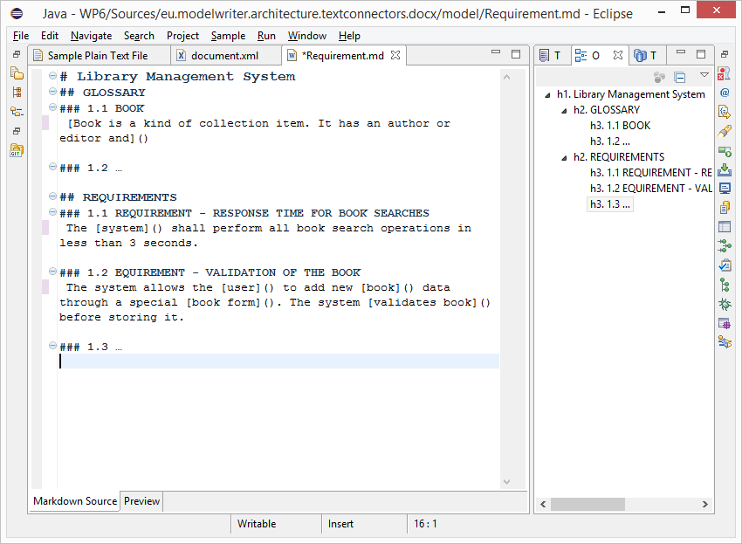
What is a text? (.md source file) text/markdown (ICANN Standard)

Slide 17
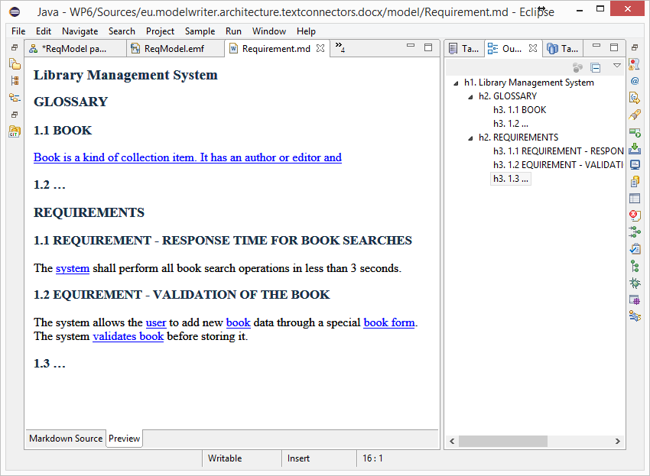
What is a text? (HTML Preview) text/markdown (ICANN Standard)

Slide 18
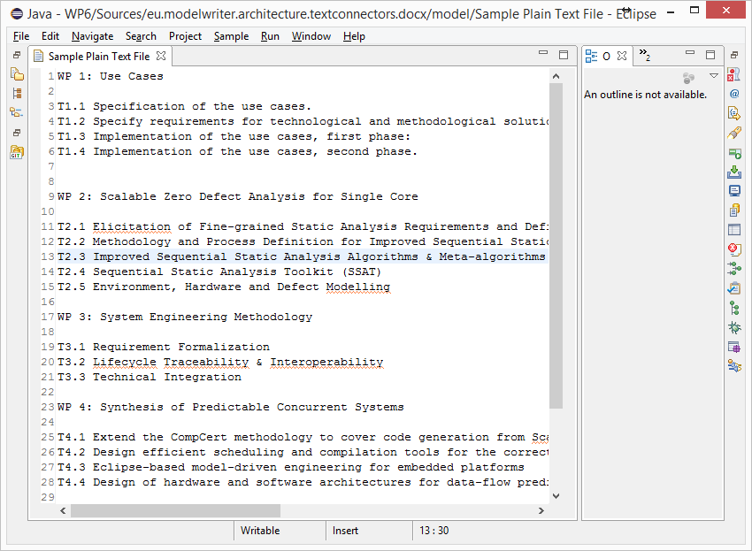
What is a text? (unformatted text) text/plain (ICANN Standard)

Slide 19
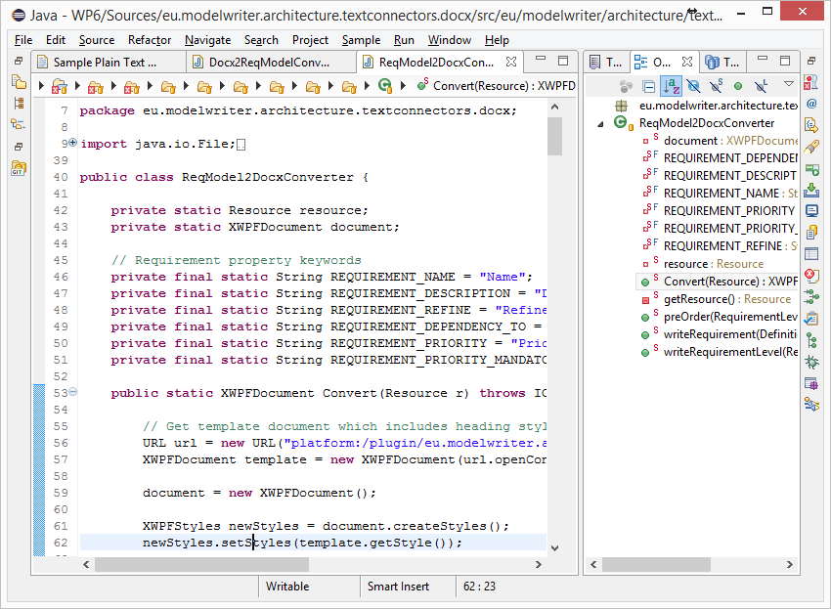
What is a text? (code files) Java, C++ … Programing Languages

Slide 20
What is a model?

Slide 21
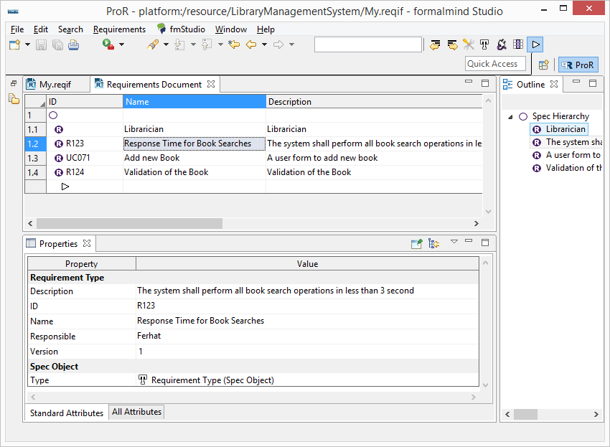
Everything is a model! (ReqIF Standard) Requirements Interchange Format

Slide 22
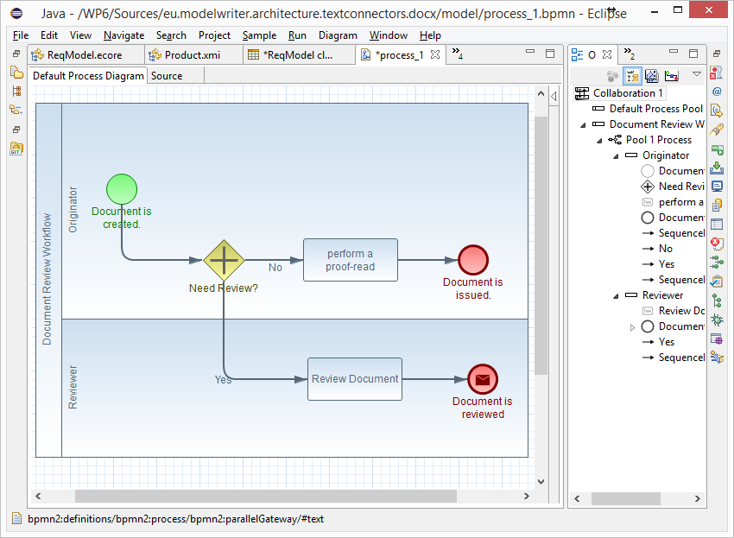
Everything is a model! (BPMN Standard) Business Process Model & Notation

Slide 23
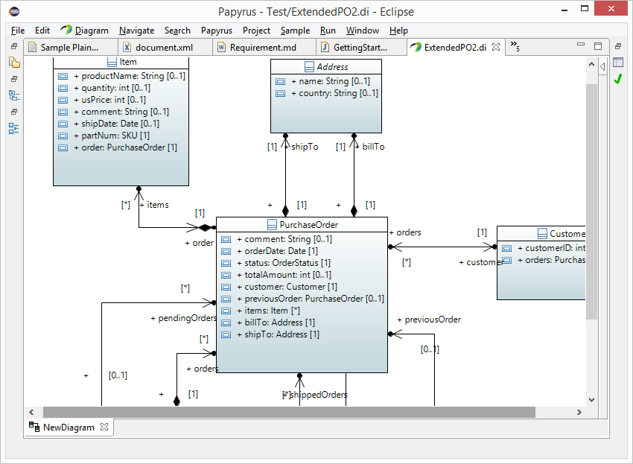
Everything is a model! (UML Standard) UML Modeling Languages

Slide 24
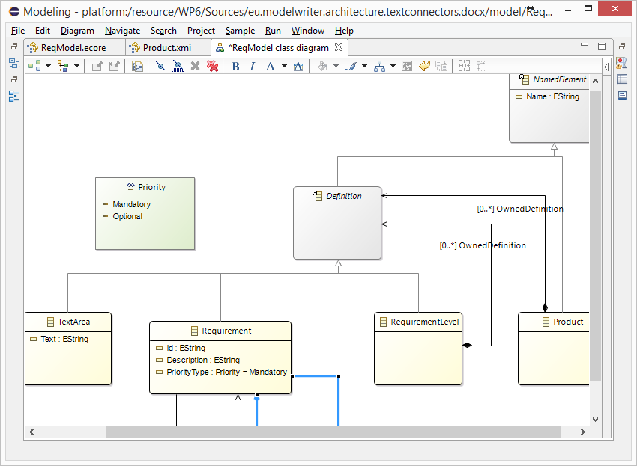
Everything is a model! Eclipse Modeling Framework (EMF)

Slide 25
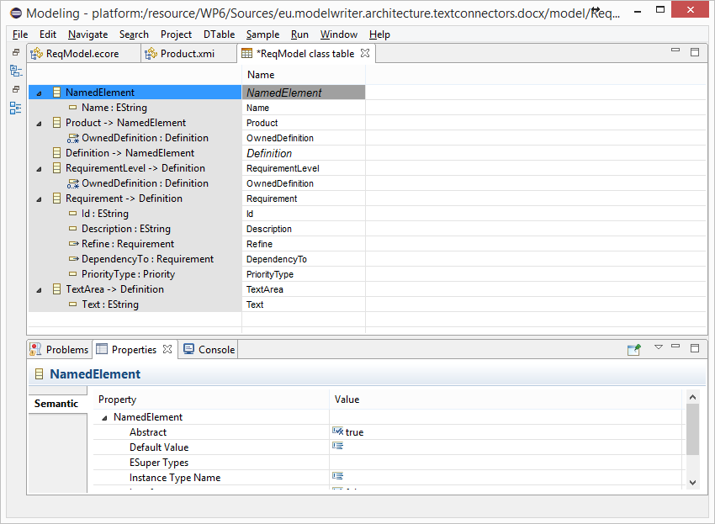
Everything is a model! Tree-based or Tabular Representations

Slide 26
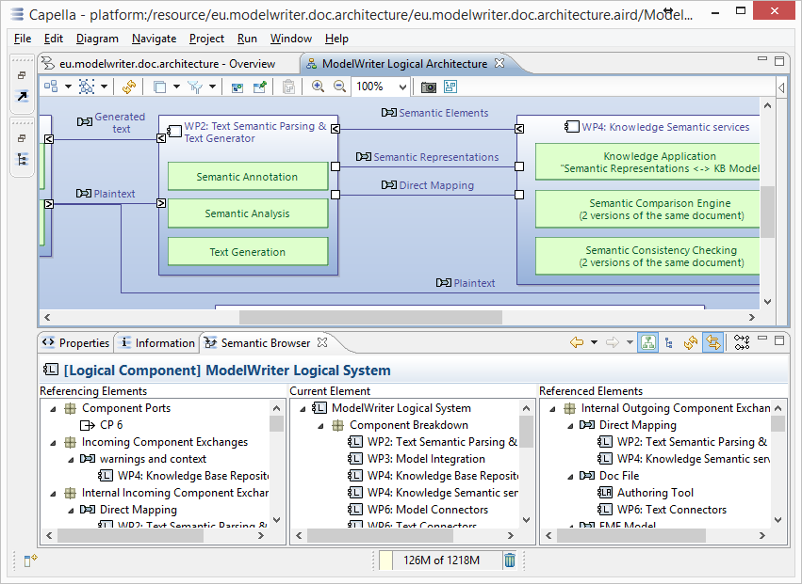
Everything is a model! Software/System Architecture Design

Slide 27
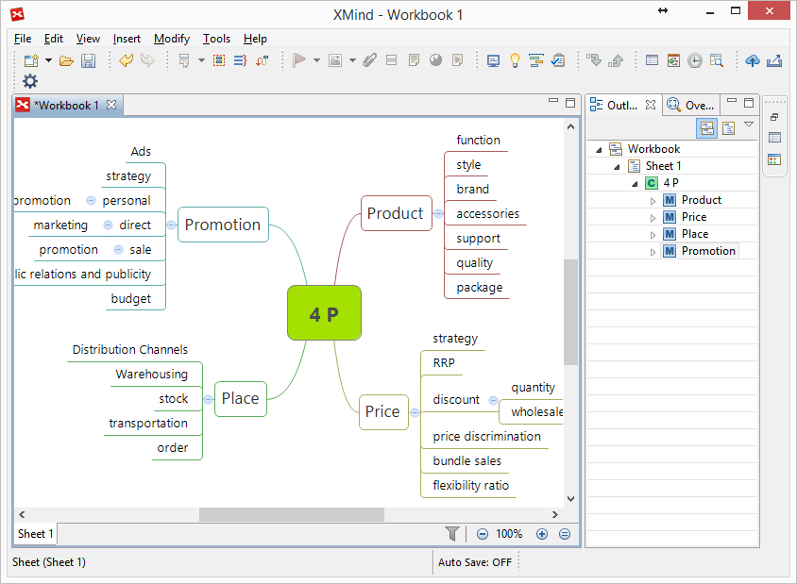
Everything is a model! Topic Maps, Mind Maps, Vocabularies …

Slide 28
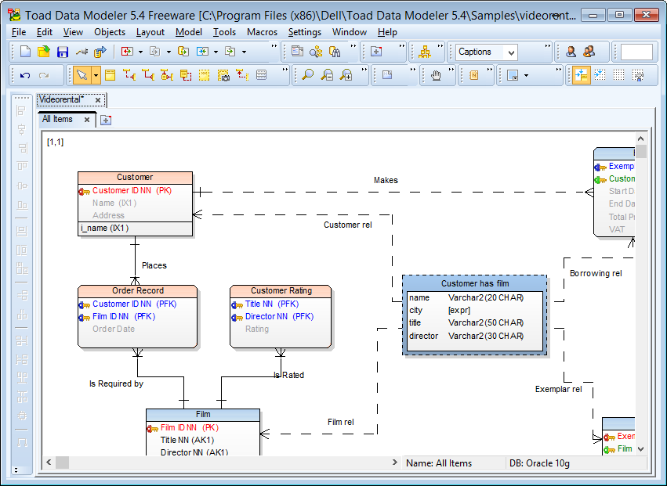
Everything is a model! Databases (ER, IDEF1.x)

Slide 29
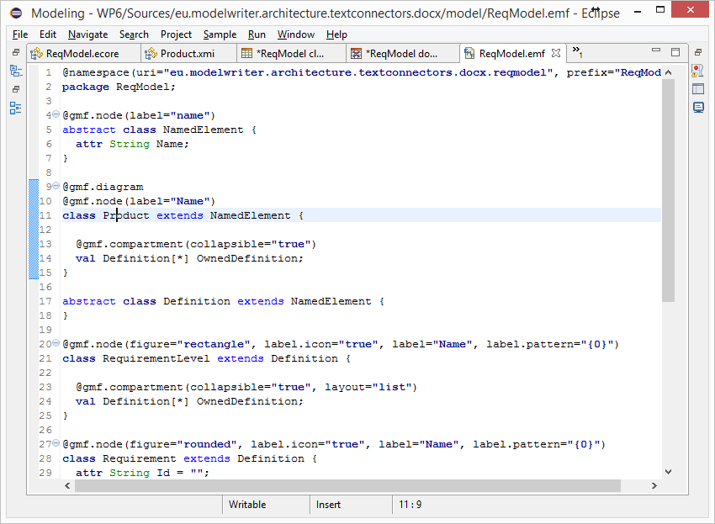
Everything is a model! (Textual Lang.) Domain Specific Languages

Slide 30
Everything is a model! (Java, C++, etc.) Even Programing Languages (ASTs)

Slide 31
Is it possible to connect and keep arbitrary software/system engineering artifacts synchronized ?

Slide 32
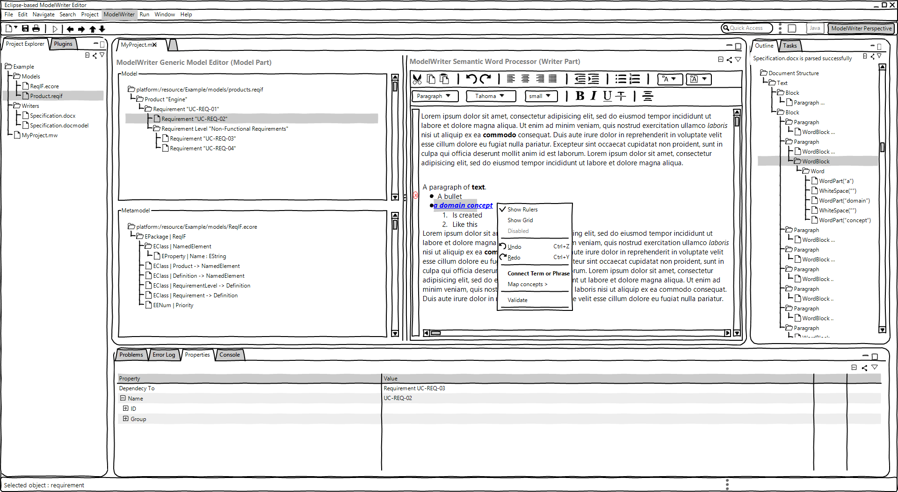
ModelWriter – The Solution
Text & Model-Synchronized Document Engineering Platform

Slide 33
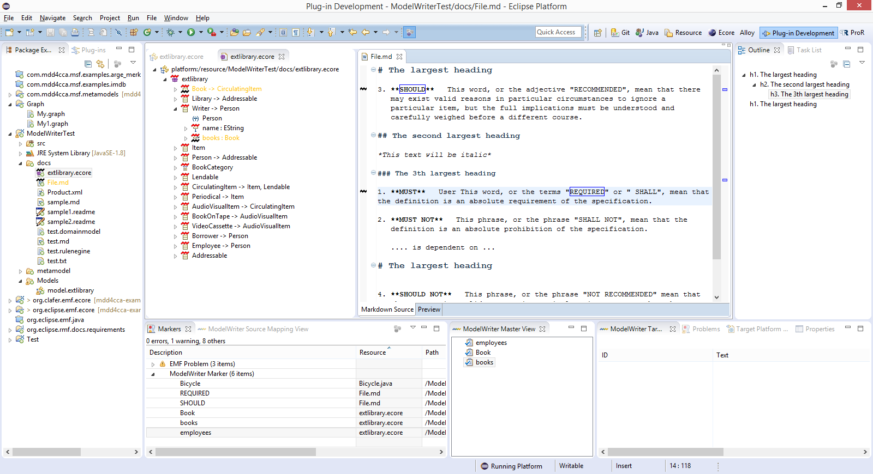
Solution – Knowledge Capture
Text & Model-Synchronized Document Engineering Platform

Slide 34
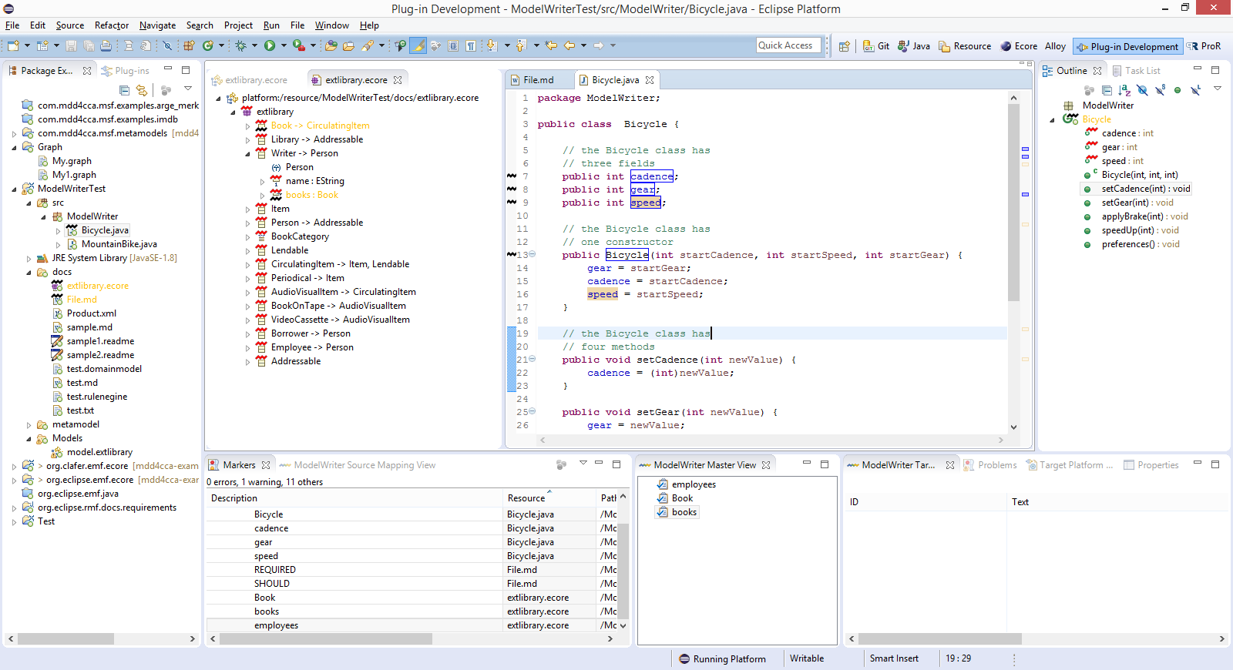
Solution – Knowledge Capture
Text & Model-Synchronized Document Engineering Platform

Slide 35
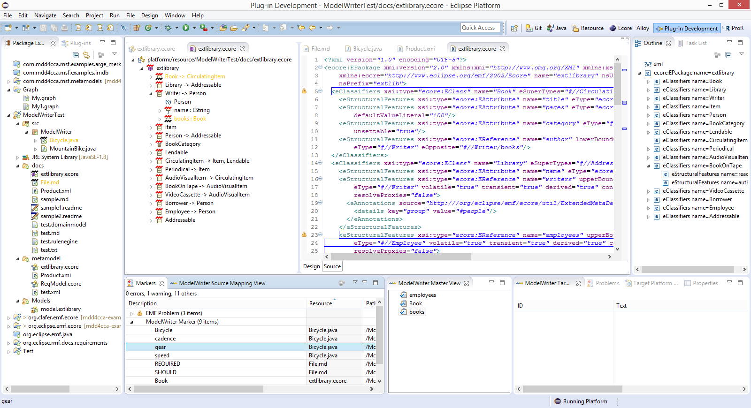
Solution – Knowledge Capture
Text & Model-Synchronized Document Engineering Platform

Slide 36
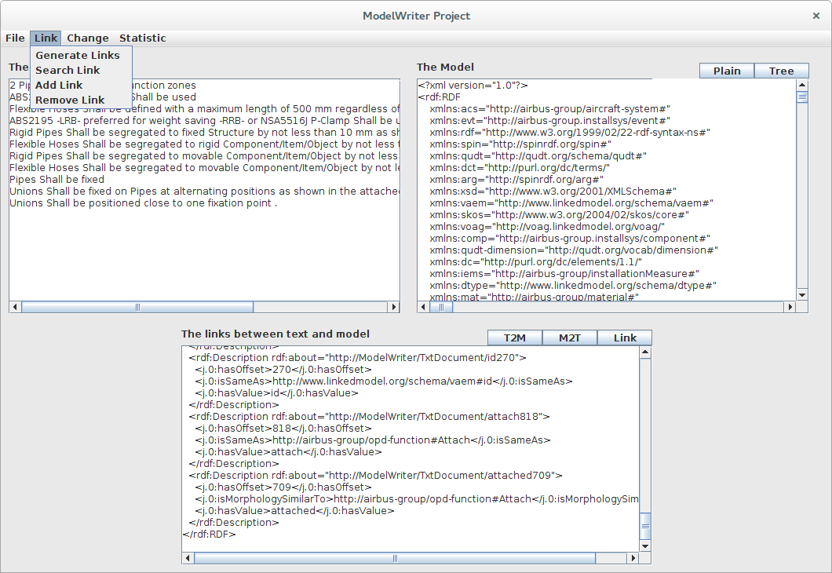
Solution – Knowledge Extraction
Text & Model-Synchronized Document Engineering Platform

Slide 37
Synchronization is maintained!

Slide 38
ModelWriter Seamless Knowledge Capture
Knowledge Capture with Word Processors
Document-centric,
Knowledge Capture with Modelling Tools
Model-centric, Structural and formal
Seamless Knowledge Capture with ModelWriter
ModelWriter as integrated product
Technical Documents
Natural Language
multiple information modelling and exploitation tools (= “Model” part),
and keeps both views seamlessly synchronized with each other.
Requirements, Specifications Architectural Design Documents..
Very Informal ones (mind maps, text tables, spreadsheets)
Formal ones (UML, SysML, EMF, BPMN …)
Text-based
a Word Processor (= “Writer” part)

Slide 39
ModelWriter Text-Based Knowledge Extraction
Understands the various textual parts of a document expressed in Natural Language
Reveals concepts and relationships between them (“Model”-part)
Semantic Word Processor
(Text-Based Knowledge Extractor)
Consistency & Completeness Checking

Slide 40
ModelWriter Quantification of the expected benefits
Improvement in quality and productivity of technical documentation.
Quality increase of the product with consistent requirements and designs.
For instance, according to AIRBUS’s claims in their use cases, the global saving would be 5 M€ to 7 M€ (A350 Recurring Cost)
50% reduction of costs for keeping the documentation up-to-date with the developed software

Slide 41

ModelWriter Architecture
Editor
Documents
(doc, docx, odt,textile,etc)
Text
Connectors
Text
Semantic
Module
KB
Model
Models Connectors
Model Integration
Module
Model
Models

Slide 42
ModelWriter: Work packages & Concrete Results
WP3 (UNIT)
WP4 (MANTIS)
WP6 (OBEO)
WP2 (LORIA)
Semantic Word Processor
An extensible model-model transformation framework
A federated Knowledge Base and its API
A complete “ModelWriter” tool integrating of all these in a consistent
Model checker plug-in for consistency
Bi-directional sync. mechanism between texts and models
bi-directional transformation between text and formal knowledge representation
WP1 Industrial Use Cases and Requirements (AIRBUS)
WP5 Project Management (UNIT)
WP7 Standardization, Dissemination and Exploitation (OBEO)

Slide 43
ModelWriter Industrial Use Cases (French Consortium)
Help determining the impacts of a change in the Enterprise Architecture
UC-FR-02
Enterprise Architecture
CEISAR - Center of Excellence in Enterprise Architecture
UC-FR-03
Synchronization of regulation documentation with a design rule repository
UC-FR-04
Production of a context specific design document
OBEO, TOTAL,
AIR France, AXA
This use case will explore the use of ModelWriter concept to structure and manage a repository of system installation rules.
OBEO, AIRBUS,
LORIA
Focus on building synchronized links between regulation documents in natural language and rules (as models).
OBEO, AIRBUS,
LORIA

Slide 44
ModelWriter Industrial Use Cases (Turkish Consortium)
IBM Rational Doors Plug-in and Eclipse Requirement Frameworks Sub-component which supports OMG’s ReqIF Standard.
UC-TR-03
Sync between Requirement Documentation and Feature Models
UC-TR-04 (UC-FR-01)
Requirements Engineering with SysML Designer (requirement-model consistency)
UC-TR-05
Synchronous Business Process Design with Use Cases
KoçSistem, UNIT
Demonstrate that the ModelWriter concept can be usefully applied on System design / Requirement generation activities.
UNIT, HAVELSAN
UNIT, KoçSistem
BPMN and Use Case Documentation

Slide 45
ModelWriter Business Strategy Open Source Campaign Open Call for Industrial User Stories
Shape the future ModelWriter
Early adaptation of the technology
Long Term Support

Slide 46
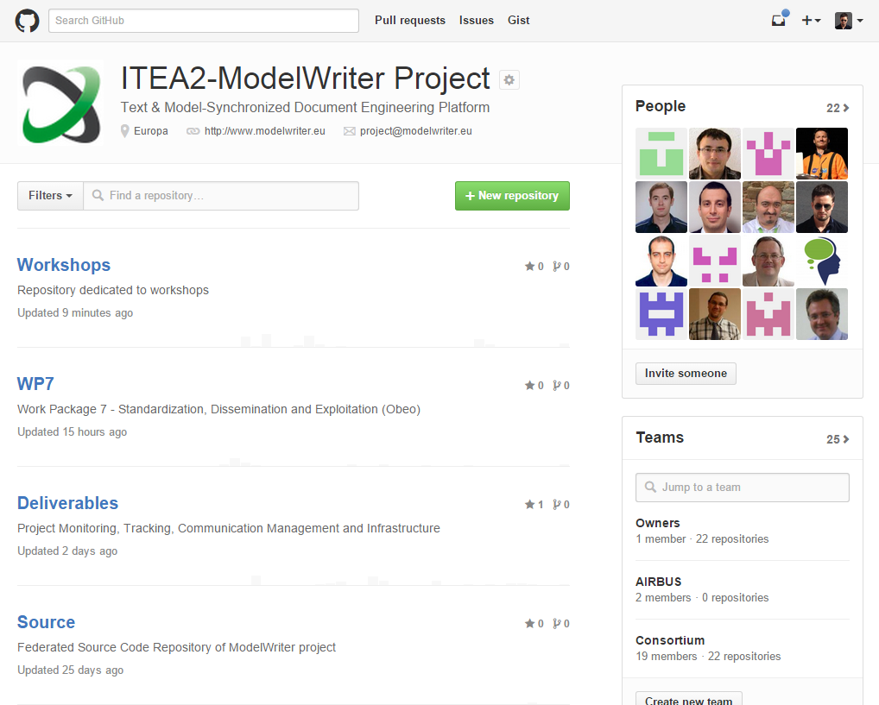
ModelWriter Open Source Campaign https://github.com/modelwriter

Slide 47
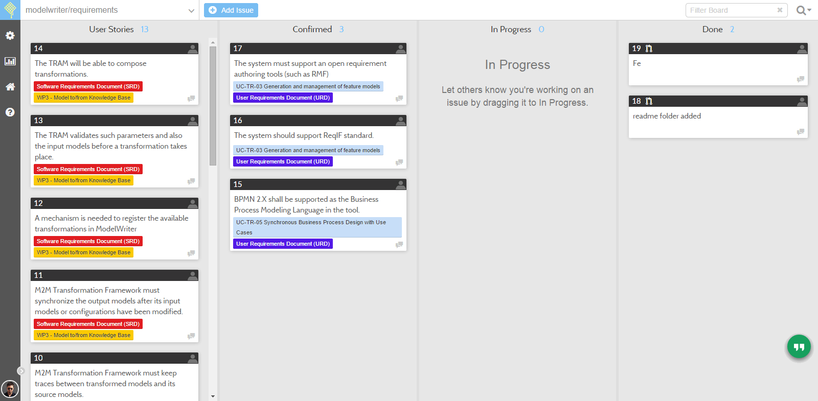
ModelWriter Requirements & User Stories https://waffle.io/modelwriter/requirements

Slide 48
ModelWriter Open Workshops in 2015 https://github.com/modelwriter/workshops
The 1st International ModelWriter Workshop in Izmir, Turkey (Jan 15-17, 2015)
The 2nd International ModelWriter Workshop in Brussels, Belgium (Apr 30, 2015)
The 3rd International ModelWriter Workshop in Toulouse, France (Jun 22-23, 2015)
The 4th International ModelWriter Workshop in Brussels, Belgium (Sep 23-24, 2015)
The 1st International Euraka Project Exhibition in Berlin, Germany (Mar 10-11, 2015)
The 5th International ModelWriter Workshop in Ludwigsburg, Germany (Nov 2-5, 2015)

Slide 49
Thank you for your attention We value your opinion and questions.

